Slide 1
Examining the variation between healthy and cancer patient plasma via PANORAMA
Pres. by Nareg Ohannesian
6-10-2021

Slide 2
Experimental Details
Received samples: HCR 55 (Healthy) and 825A (cancer)
Plasma (10 microliter) was diluted 4 times for both cases.
Concentration: unknown.
Size Distribution: Unknown.
Experimental duration: 45 min.
Antibody used: CD9, CD81, and CD63.

Slide 3
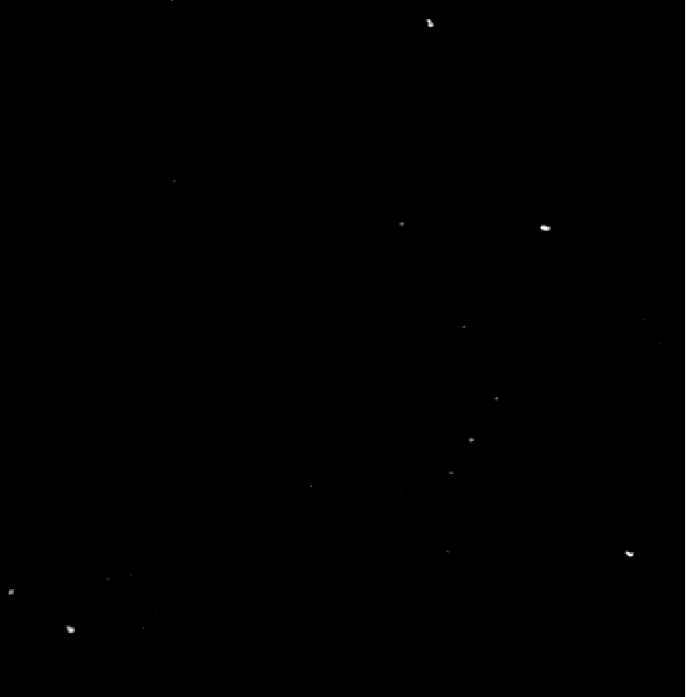
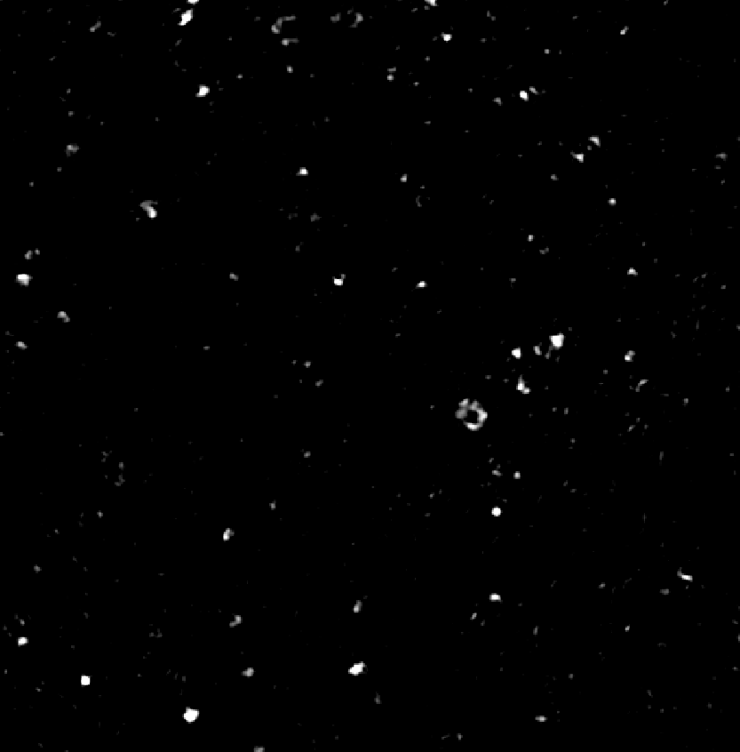
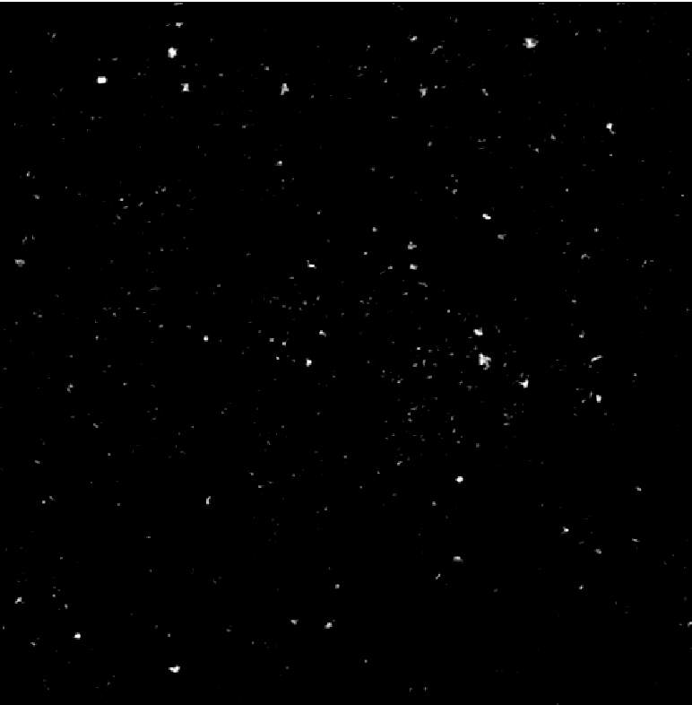
PANORAMA of plasma sample 825A at different times
PANORAMA
Time: 30 min
Count: 390
PANORAMA
Time: 45 min
Count: 939
PANORAMA
Time: 10 min
Count: 24
Scale bar: 10 µm

Slide 4
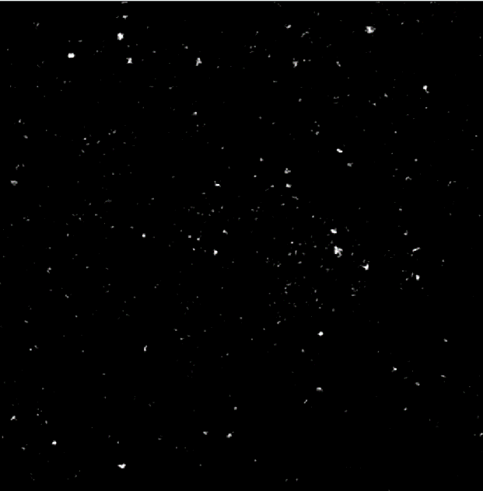
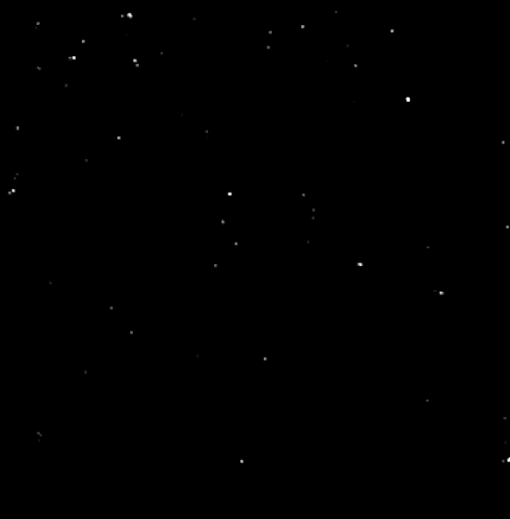
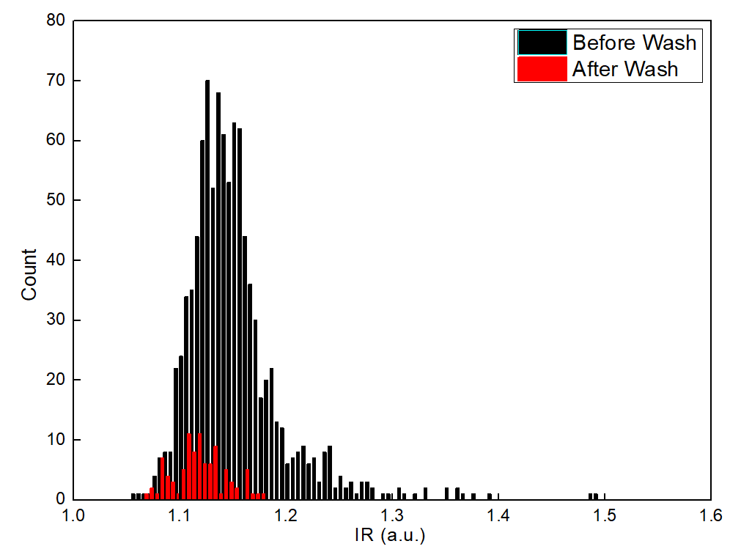
PANORAMA of plasma sample 825A before/after wash
PANORAMA (IR: 1.15 ± 0.05)
Time: 45 min wash
Count: 939
PANORAMA (IR: 1.12 ± 0.024)
Time: 45 min wash
Count: 67
7.1 % of detected particles captured after wash
Scale bar: 10 µm

Slide 5

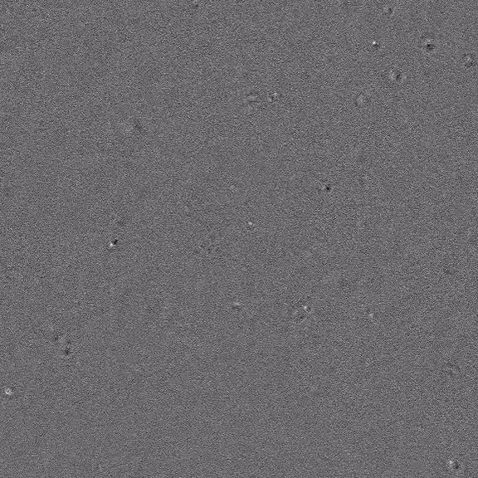
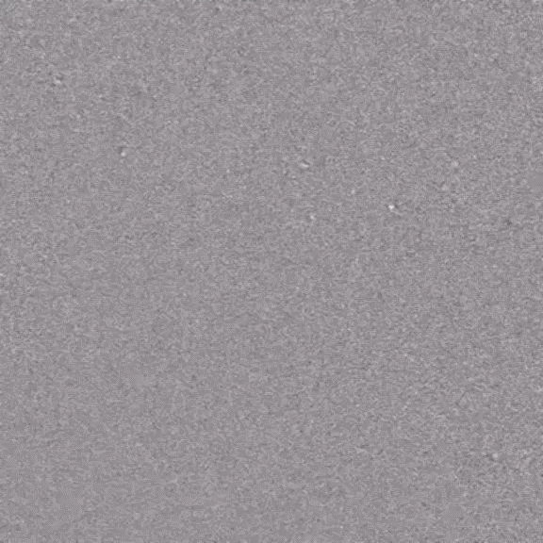
Videos: Plasma samples from 825A cancerous
Sample 825A exp. 1
Count: 80
Sample 825A exp. 2
Count: 69
Sample 825A 2nd batch
Count: 75
Video taken at time 45 min
Few exosome-like particles appear.
High number of 1-2 micron size particles.
The Background IR 1±0.012
Scale Bar: 10 µm

